Slide 1


CAPSTONE PROJECT (LOAN DATA)
CHECKPOINT 1
BY BATCH I GROUP 5

Slide 2
GROUP MEMBERS AND THEIR RESPONSIBILITIES
1. Shubhaditya Dutta
2. Narayani Patil
3. Chinmay Raut
4. Jayanth Marisetty
5. Rimjhim Gupta

Slide 3
Task 1.1- Data Manipulation using Python
Problem Statement-
Analysis of percentage of default and check whether it is imbalanced data?
Replace missing values with appropriate techniques.
Use the right treatment for outliers in the data.
Analyse default variable with demographic related data.
Determine and draw insights on association between default and other variables, both categorical and numerical.

Slide 4
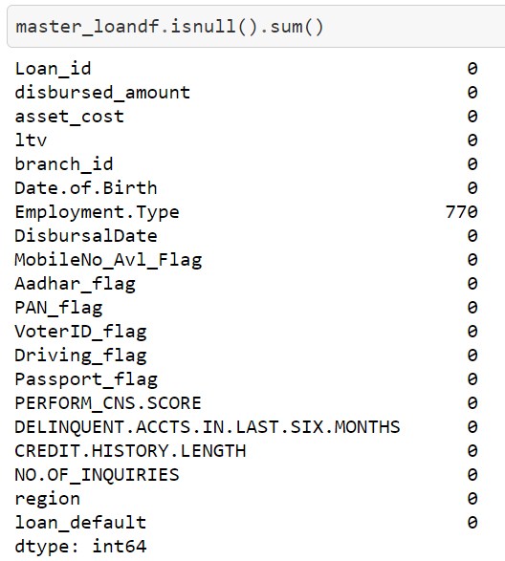
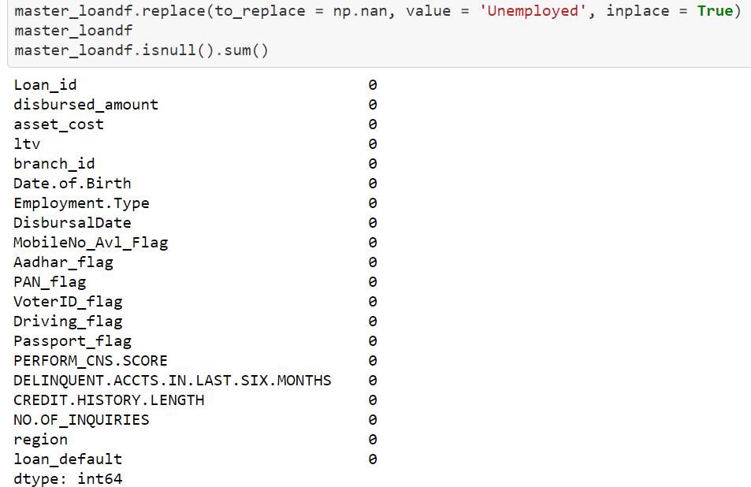
Approach to solution-
Step 1: Load the given datasets in Jupyter Notebook.
Step 2: Combine the subsidiary data to form a master dataframe.
Step 3: Find the missing values.
Our dataset had 770 missing values for Employment.Type. We assumed that these missing values are unemployed customers.

Slide 5
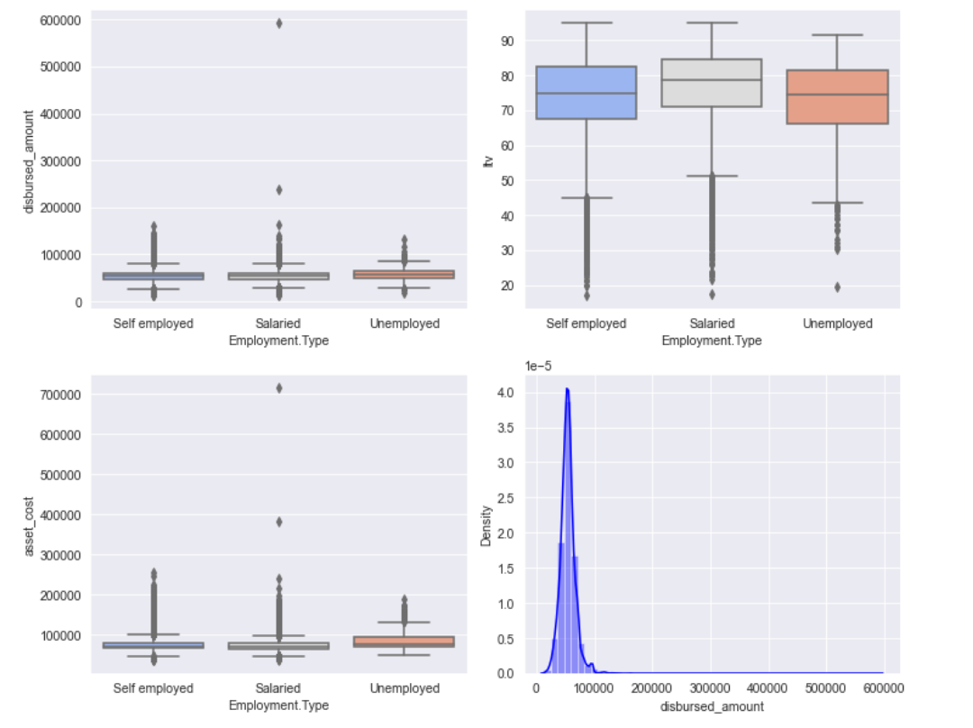
Step 4: Detect the outliers and treat the dataset for outliers.
In our dataset, any disbursed_amount value which is above 99.99th quantile will be capped at 99.99th quantile while any value below 1st quantile will be capped at 1st quantile. This sets the upper and lower limits for outliers.
Step 5: Age has been calculated to analyze the demographic distribution.
Step 6: Assess the data based on default status.
It suggested that nearly 22% of the given data belongs to default category and rest of the data belongs to the non-default category. It may lead to majority oversampling if the whole dataset is considered for training the model.

Slide 6
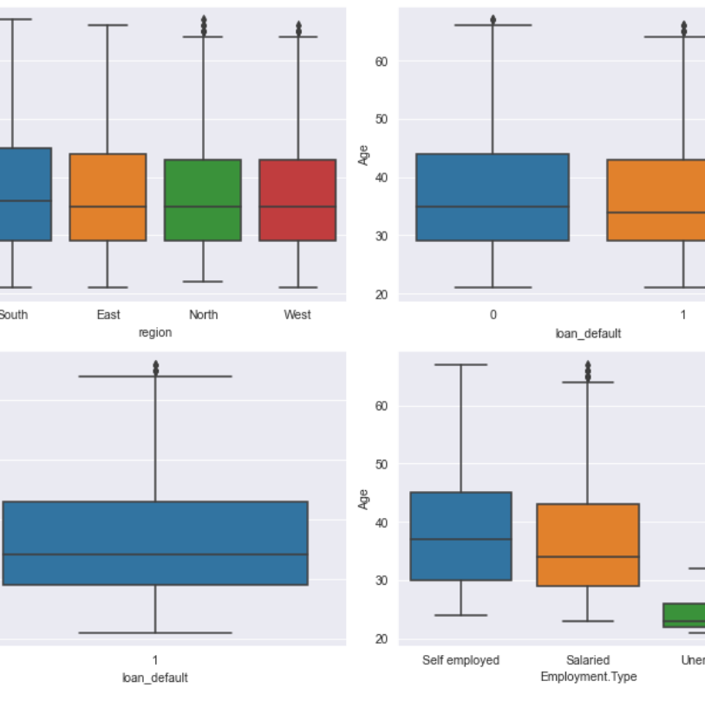
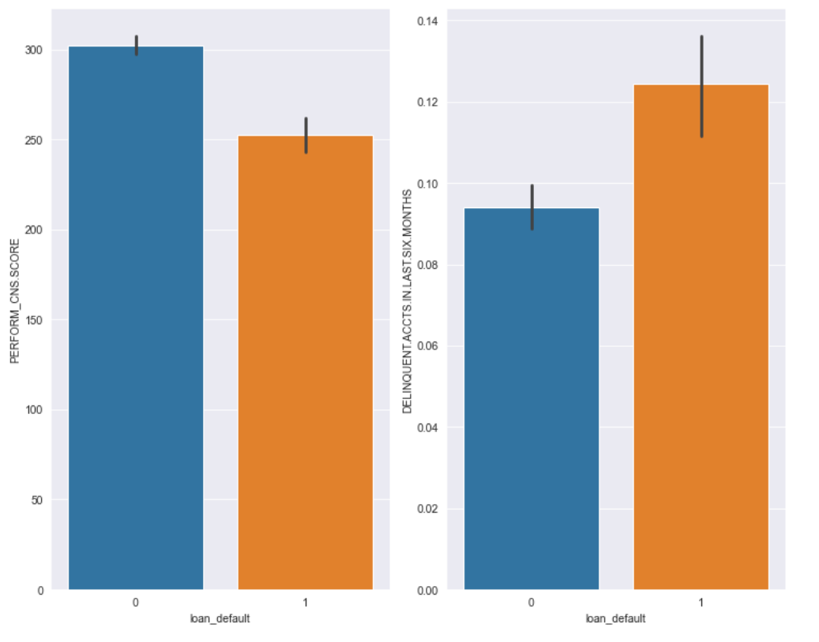
Step 7: Analyze the dataset based on categorical data like 'Region’, 'Employment Type’, 'CNS Score' and 'Delinquent Account count’.

Slide 7
CONCLUSION
From the analysis, we can conclude the following-
The young population (20-30 years of age) is majorly unemployed and are more susceptible to default.
The customers with lower bureau score and high delinquent accounts are more susceptible to default.
The given data is imbalanced with 22% default data-points. To train the model we have more non default data-points but less default ones so the model might not be good at predicting defaults and might give false negatives or type 2 error.

Slide 8
THANK YOU

